Slide 1
Docker

Slide 2
Docker is a tool for running your applications inside containers.
Containers package all the dependencies and code your app needs to run into a single file, which will run the same way on any machine.

Slide 3
What Is Docker?
Docker is similar in concept to Virtual Machines, except it’s much more lightweight.
Instead of running an entire separate operating system (which is a massive overhead), Docker runs containers, which use the same host operating system, and only virtualize at a software level.

Slide 4
What can I use Docker for?
Fast, consistent delivery of your applications
Docker streamlines the development lifecycle by allowing developers to work in standardized environments using local containers which provide your applications and services. Containers are great for continuous integration and continuous delivery (CI/CD) workflows.
Consider the following example scenario:
Your developers write code locally and share their work with their colleagues using Docker containers.
They use Docker to push their applications into a test environment and execute automated and manual tests.
When developers find bugs, they can fix them in the development environment and redeploy them to the test environment for testing and validation.
When testing is complete, getting the fix to the customer is as simple as pushing the updated image to the production environment.

Slide 5
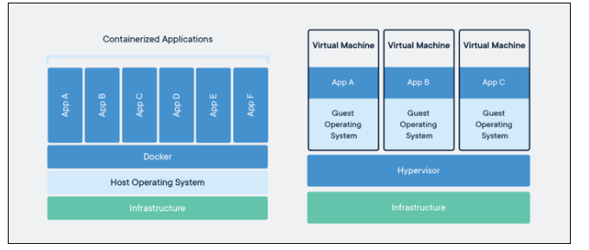
Docker Engine runs on Linux, Windows, and macOS, and supports Linux and Windows for Docker containers.
The exact flavor of Linux doesn’t actually matter; most versions of Linux will run the same kernel, and only differ in the user software.
Docker can install this user software to the container, allowing you to run a CentOS container on Ubuntu.
You couldn’t though, for example, run FreeBSD on Ubuntu, since the kernels are different.

Slide 6
Docker installation

Slide 7
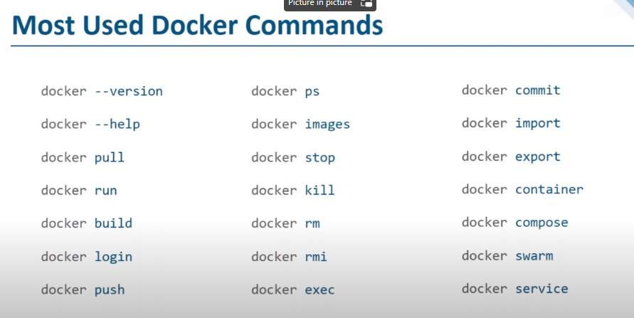

Slide 8
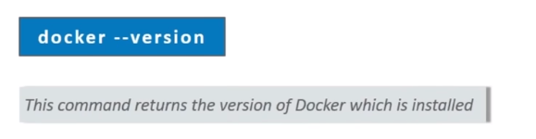

Slide 9
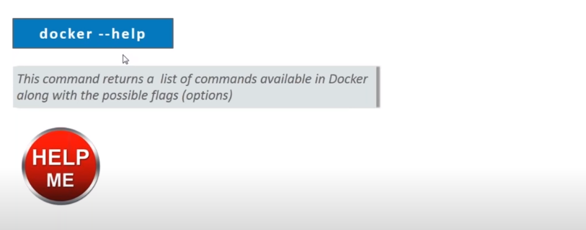

Slide 10
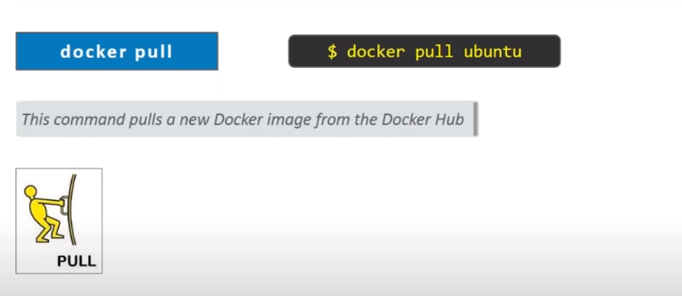

Slide 11
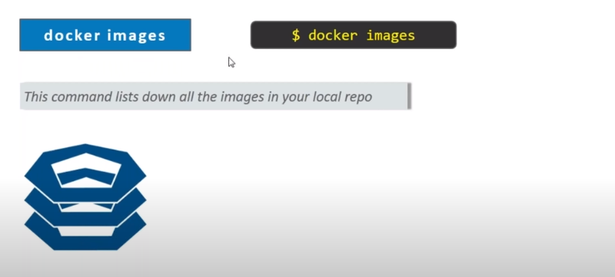


Slide 12
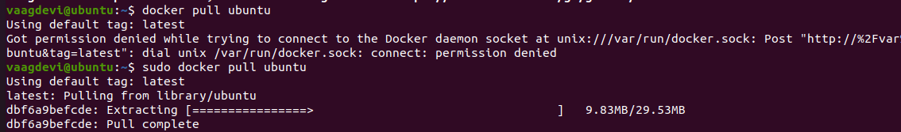
DOCKER PULL UBUNTU

Slide 13
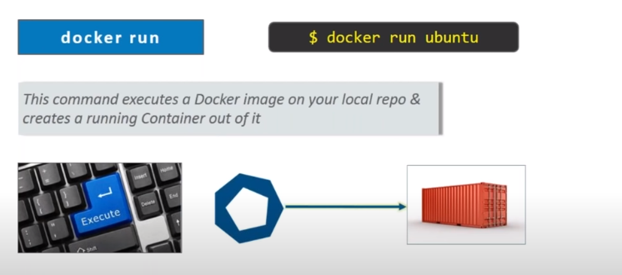

Slide 14
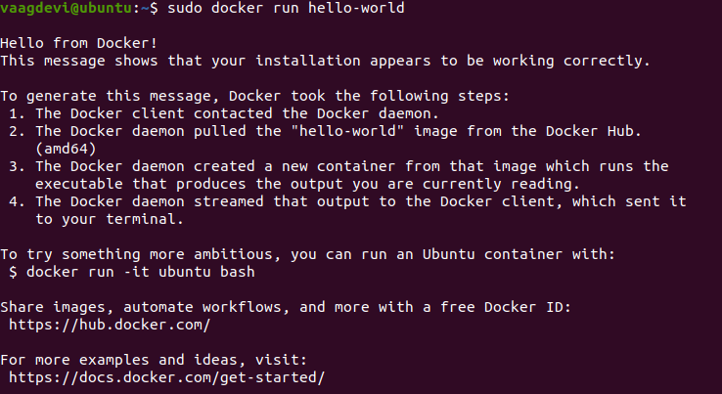
DOCKER RUN HELLO WORLD

Slide 15
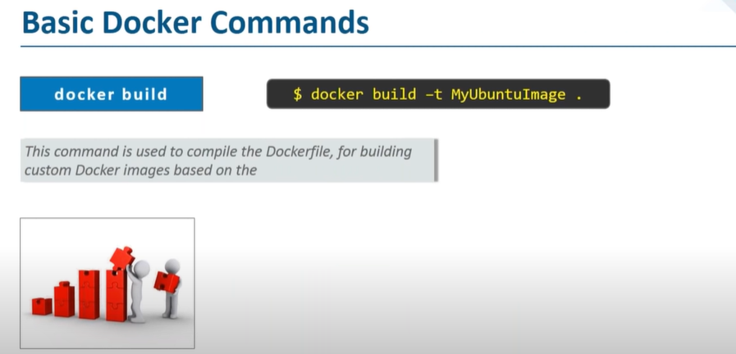

Slide 16
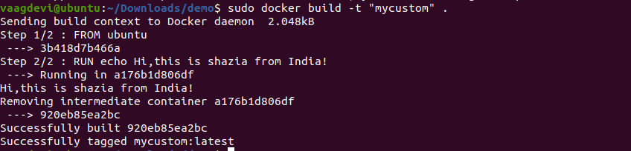

Dockerfile(no extension to be given)

Slide 17

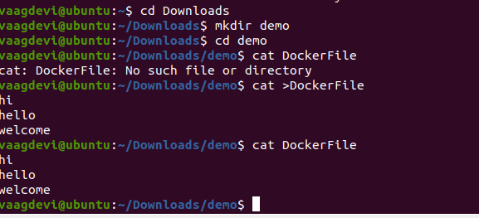
PWD and creating a directory
Present working directory

Slide 18
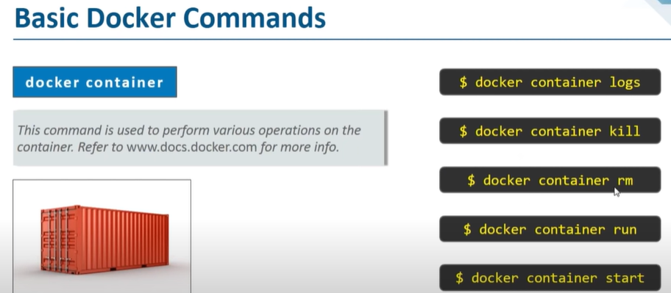

Slide 19
Docker container
To remove the container
Don’t try the above command

Slide 20
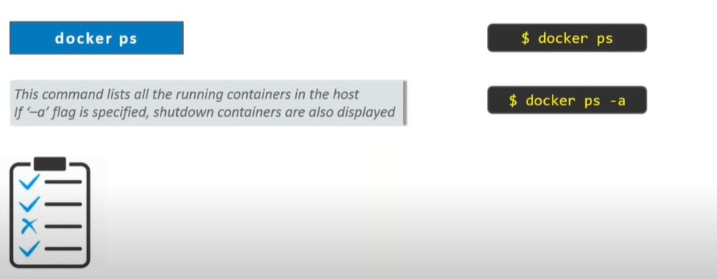

Slide 21
Ps commands

Slide 22
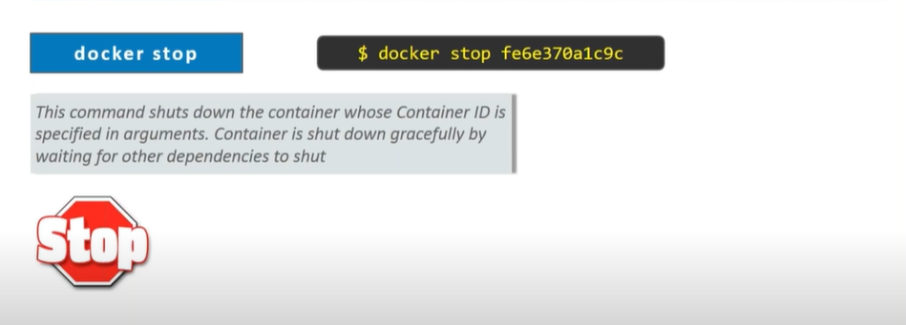
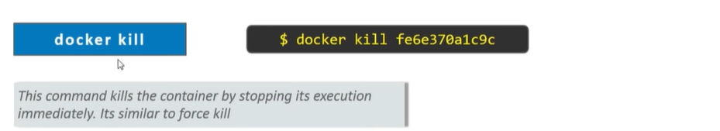

Slide 23
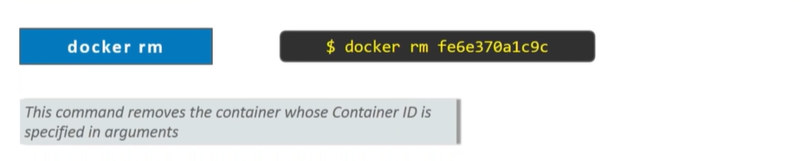


Slide 24
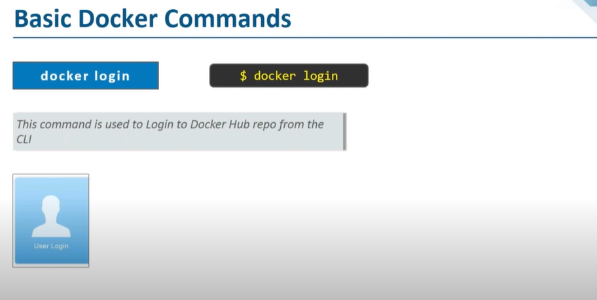

Slide 25
Username:vaagdevi
Password:vaag123456
Once u login now u can start pushing…that’s our next command

Slide 27
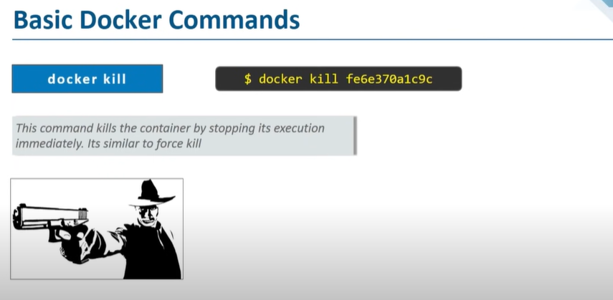

Slide 28
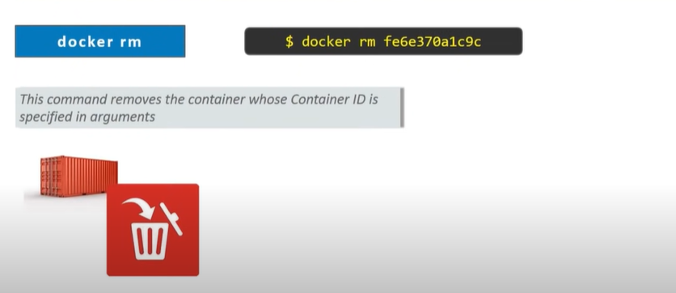

Slide 29
